Slide 1
Linear regression

Slide 2
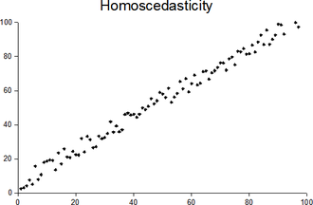
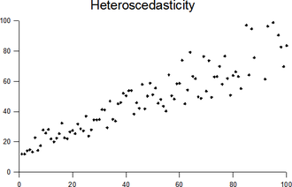
LR ASSUMPTION: ERROR HAS CONSTANT VARIANCE
No significant impact on estimator, remains unbiased.
Heteroscedasticity has impact on the std error, confidence interval of coefficients, acceptance and rejection of hypothesis testing, inference conclusion.
Inference: generalizing observations and properties for a population based on a sample

Slide 3
Simpson’s paradox
Simpson's paradox, which also goes by several other names, is a phenomenon in probability and statistics, in which a trend appears in several different groups of data but disappears or reverses when these groups are combined.
This result is often encountered in social-science and medical-science statistics^{[1][2][3]} and is particularly problematic when frequency data is unduly given causal interpretations.^{[4]} The paradox can be resolved when causal relations are appropriately addressed in the statistical modeling.^{[4][5]} It is also referred to as Simpson's reversal, Yule–Simpson effect, amalgamation paradox, or reversal paradox.^{[6]}
https://en.wikipedia.org/wiki/Simpson%27s_paradox#/media/File:Simpsons_paradox_-_animation.gif

Slide 4
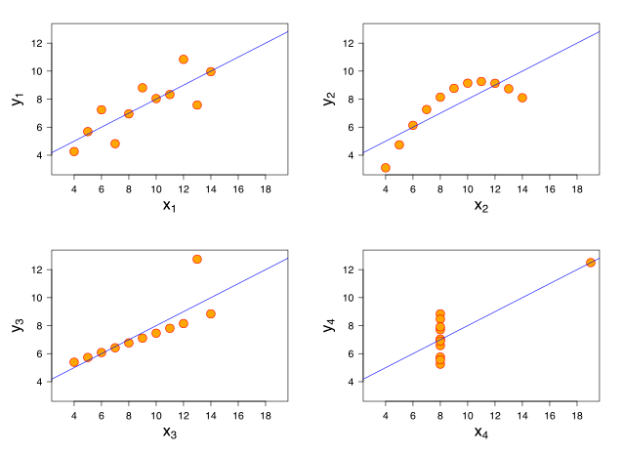
General: DataScience
Data scientis: The best data scientists are not those who know the most complex algorithms, but those who have a very good knowledge of the data, and have prepared the ground carefully beforehand.
Below a representation of d’Anscombes Quartet that underlines the necessacity of evaluation
Anscombes Quartet: All four sets are identical when examined using simple summary statistics, but vary considerably when graphed.
(https://en.wikipedia.org/wiki/Anscombe%27s_quartet)

Slide 5
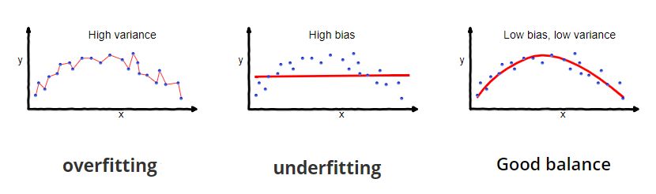
Bias variance trade-off
Overfitting | Low Bias & High Variance – Complex models, sensitive to noise – To much adapted to training data
The notion of overfitting refers to the fact that the model is too close to the training data. This is a classic problem in data science, when you choose a model that is too "flexible", i.e. with too high a complexity that also takes into account the noise of the phenomenon.
Underfitting | High Bias & Low Variance – Oversimplified model – Not enough ‘trained’
The notion of underfitting refers to the fact that the model is unable to capture the underlying pattern of the data. In this case the chose model is oversimplified which leas to high bias but low model variance.

Slide 6
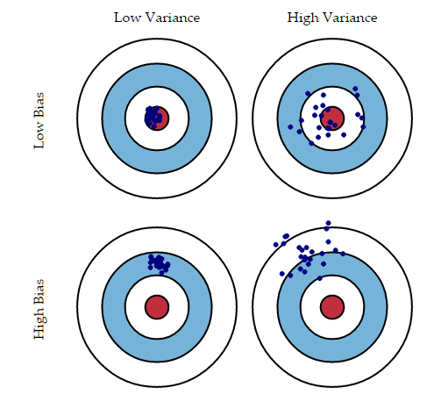
Bias variance trade-off
In general, but not always, models with:
Low variance have a high bias: predictive model misses relevant information
High variance have a low bias: model is to sensitive to changes in input data, not stable

Slide 7
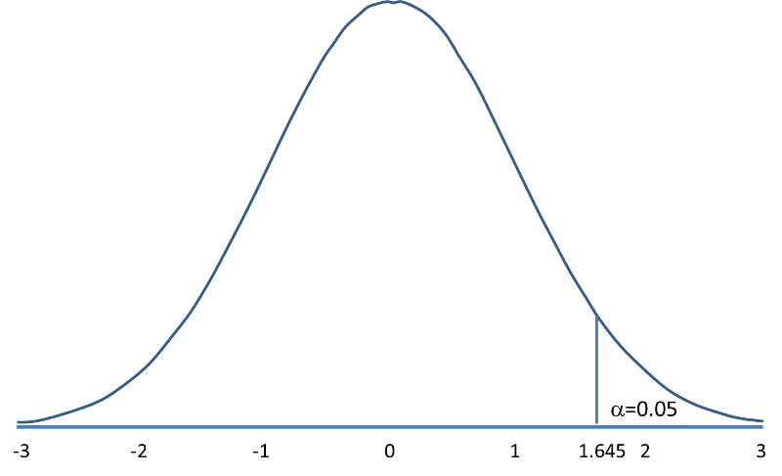
Hypothesis testing (again ☺ ): In-depth
Mean weight (pounds)
H0: μ = 191
H1: μ ≠ 191
The sample mean is higher than H0 hypothesis. But is the difference more than can be expected based on chance?
Based on sample mean, we try to draw conclusions for the whole population. Based on a standard normal distribution, what is the probability that X > 197.1?
Total US population
Sample with:
Xm = 197.1
Sd = 25.6
n = 100
Remember : z = (X –mu) / (std / sqrt(n) )
Z = 2.38, and P(X> 197.1) = 0.0087 (~1%)
Z-value
Z-sample = 2.38
https://sphweb.bumc.bu.edu/otlt/mph-modules/bs/bs704_hypothesistest-means-proportions/BS704_HypothesisTest-Means-Proportions2.html

Slide 8
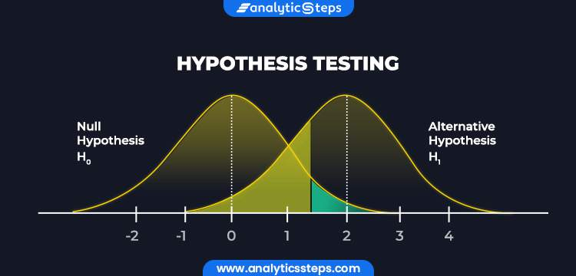
Hypothesis testing (again ☺ ): In-depth
E.g. Regression coefficients:
H0: β = 0
H0: β ≠ 0
With OLS we find values for the beta’s. Now, under the H0 hypothesis, what is the probability of a given beta value. If very small (<0.05), then we reject H0.
p-value = probability of making a type I error: rejecting the H0 hypothesis while it is true

Slide 9
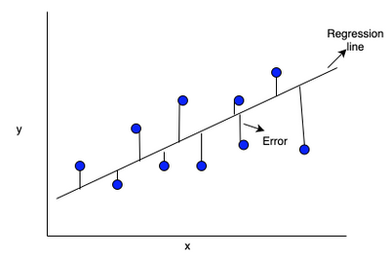
Ordinary Least Square
Find a regression model with the objectif:
- Minimize the sum of squared errors

Slide 10
MSE versus R2
MSE
R2
SSE = sum (y_real – y_predict)^2
MSE = SSE / n
MSE only compares real value with the predicted.
SSE = sum (y_real – y_predict)^2
SST = sum (y_real – y_mean)^2
R2 = 1 – SSE / SST
R2 compares SSE with the variance of the response (y_mean and y_real).

Slide 11
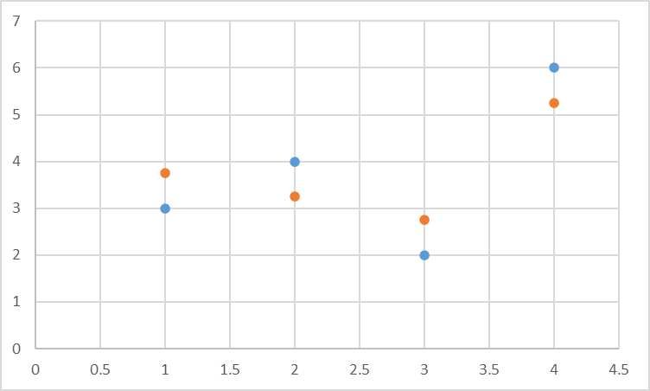
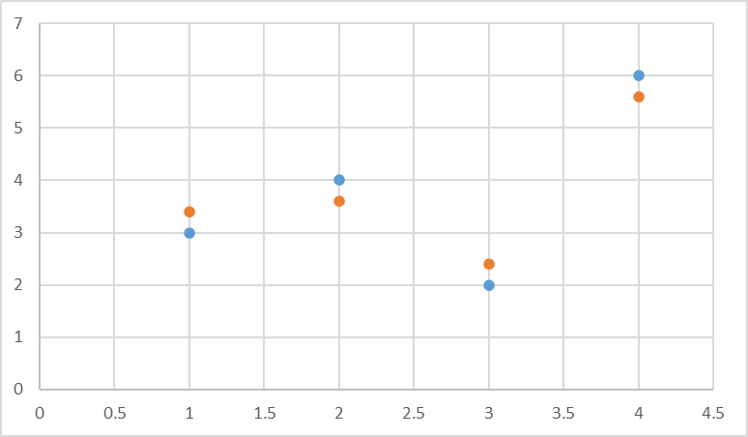
MSE versus R2. Same Data & Different models
Same SST, but different SSE. Thus different R2.
Right model predicts Y with less error

Slide 12
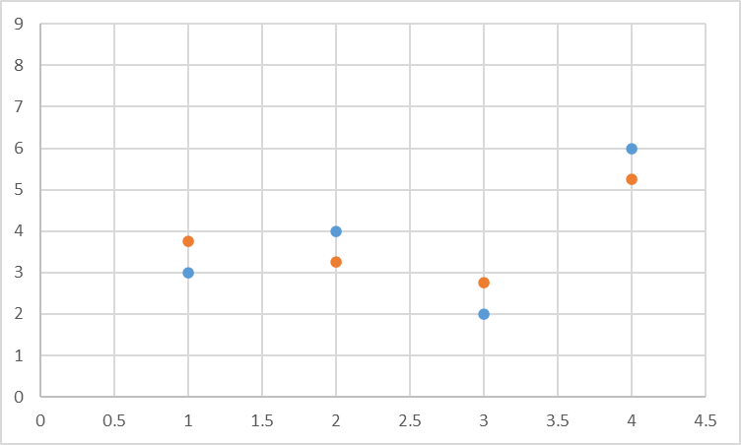
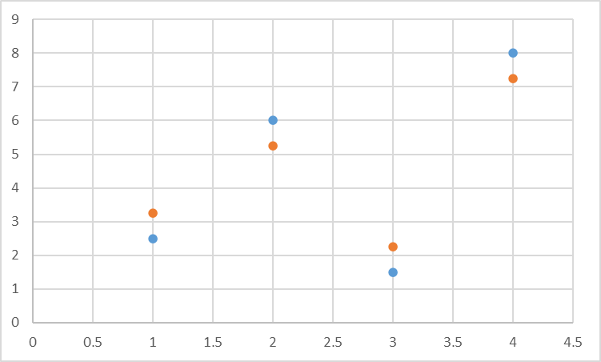
MSE versus R2. Different data & models
Same MSE, but higher variance. Thus different R2.
Right model is better at explaining capturing variance

Slide 13
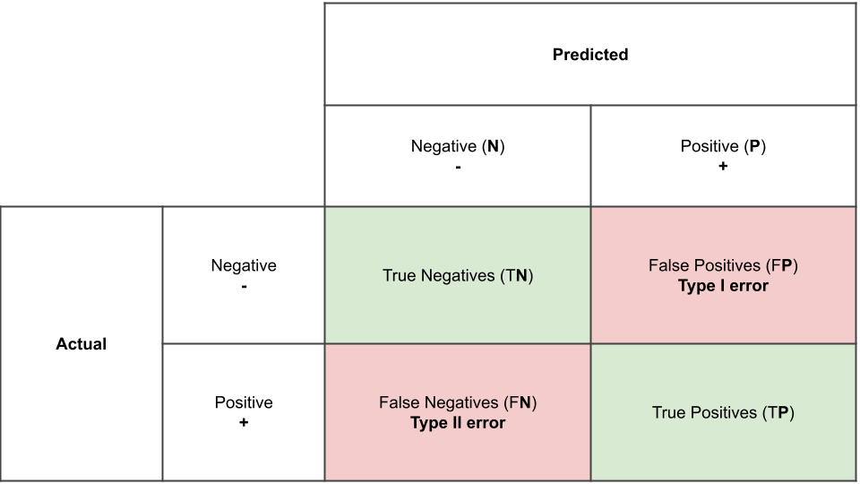
Confusion Matrix
Email spam. Let’s say that 5% of received email is spam. Hence, 95% is good mail
Simplest approach to “predict” non-spam mails. Blindly pick mails at random, based on 5% and 95% rule, and put in the “spam” mail class.
This would probably result in good mails being classified correctly close to 95%.
But what about the spam mails?

